Slide 1








New Constructions of Functional Adaptor Signatures:
Broader Functions and Improved Efficiency
Nikhil
Vanjani
nikhilvanjani61@gmail.com
Garrett
Greiner
garrett.greiner@utah.edu
Sri AravindaKrishnan Thyagarajan
aravind.thyagarajan@sydney.edu.au
Pratik
Soni
pratik.soni@utah.edu
Notes:
Thanks for the introduction. I am Nikhil Vanjani and today I will be presenting our work on Functional Adaptor Signatures. This is joint work with my amazing collaborators Garrett, Aravind, and Pratik. This work was done when I was at CMU. I recently finished my PhD there and have started as a Senior Researcher at Babylon Labs.
0:30

Slide 2
Functional Adaptor Signatures
Cryptographic tool
to enable
Fair Exchange of Digital Goods
Cryptographic tool
to enable
Functional Fair Exchange of Digital Goods

Slide 3


Fair Exchange of Digital Goods
Blockchain as a TTP
money
money
data = x
data = x
Buyer
Seller
Fairness: if money sent, should receive data
Infrastructure
Costs
Compatibility
Fairness: if data sent, should receive money
[Pagnia-Gärtner’89]: impossible without a trusted third party (TTP)
Notes:
Consider a scenario of fair exchange of digital goods. Here, a seller holds some data x and a buyer is interested in paying some money to buy it.
Crucially, both of them don’t trust each other and thus require fairness from the protocol as follows.
buyer fairness means that if the money is sent, then it should receive the data.
Similarly, seller fairness requires that if the data is sent, then it should receive the money.
Pagnia and Gartner in 1989 showed that such a fair exchange is impossible without a trusted third party.
Recently, blockchains have been used as a trusted third party to overcome the impossibility and to build fair exchange protocols.
In such a case, for efficiency we also require that infrastructure costs stay low and the solutions are compatible with various blockchains.
6:00

Slide 4
Functional Fair Exchange of Digital Goods
Blockchain as a TTP
money, f
money,
f: function
x: sensitive info
data = f(x)
Buyer
Seller
Fairness: if money sent, should receive data
Infrastructure
Costs
Compatibility
Fairness: if data sent, should receive money
Privacy: buyer should learn nothing beyond f(x)
Notes:
Functional Fair Exchange generalizes this problem to the setting where the data x held by the seller is sensitive information and the buyer is interested to learn a function f evaluated on it. Here, in addition to fairness, the seller also requires data privacy which means that the buyer should learn nothing beyond f(x) about x.
6:30

Slide 5
Application: Machine Learning
Blockchain as a TTP
money, f
money,
f: function
(Eg: fine-tuning ML model)
x: sensitive info
(Eg: medical records)
data = f(x)
Data Privacy Regulations.
Eg: HIPAA
Buyer
(Researcher)
Seller
(Hospital)
Privacy: buyer should learn nothing beyond f(x)
Notes:
There are two natural kinds of application domains for considering functional fair exchange.
First, consider ML application where the function f describes fine-tuning an ML model ,data x is medical records, buyer is a researcher and seller is a hospital. This scenario is interesting since data privacy regulations such as HIPAA may prevent the hospital from selling medical records of its patients, but may allow selling specific function evaluations to advance scientific research.
7:15

Slide 6
Application: Cryptography
Blockchain as a TTP
money, f
money,
f: function
(Eg: Sign)
x: sensitive info
(Eg: signing key)
data = f(x)
Cryptographic
Privacy Requirement
Buyer
(Certificate Client)
Seller
(Certificate Issuer)
Privacy: buyer should learn nothing beyond f(x)
Notes:
Second natural style of application are cryptographic in nature. For example, f describes signing algorithm, x denotes signing key, buyer is a certificate client and seller is certificate issuer. Here, it is crucial to keep the signing key hidden for cryptographic privacy purposes.
7:45

Slide 7






Fair Exchange via Smart Contracts + PKE
1
$$ad=(K, ct)$$
money
data = x
Buyer
Seller
1
$$(k, K=g^{k}) ←EG.Setup(1λ)$$
2
$$ct ←EG.Encrypt\left(K, x\right)$$
Lock money
$$k$$
Smart Contract [K]
3
Release money
Verify $(K, k)∈R_{DL}$
$$x←EG.Decrypt(k, ct)$$
4
Notes:
Having motivated functional fair exchange, let me explain how we can build it. For this, let’s start with seeing how plain fair exchange can be obtained using smart contracts and PKE.
The seller samples El Gamal key pair little k and capital K = g^k, encrypts message x using K and sends advertisement ad=(K, ct) to the buyer. They setup a smart contract with encryption key K hardcoded in it.
Next, the buyer locks the money in to the contract.
Upon seeing this, the seller publishes key k on the smart contract. The smart contract verifies if (K, k) satisfy discrete-log relation and if so releases the money to the seller. Lastly, the buyer can observe the published key k and use it to decrypt the ciphertext and obtain message x. This completes the description of the fair exchange protocol.
9:45

Slide 8








Functional Fair Exchange via Smart Contracts + FE
1
$$ad=(ek, ct)$$
money,
f: function
(Eg: fine-tuning ML model)
x: sensitive info
(Eg: medical records)
2
$$f$$
Buyer
Seller
1
$$(ek, dk) ←FE.Setup(1λ)$$
2
$$ct ←FE.Encrypt\left(ek, x\right)$$
Lock money
3
$${dk}_{f} ←FE.KGen(dk, f)$$
$${dk}_{f}$$
Smart Contract [ek, f]
3
Release money
Verify $(ek, f,{dk}_{f})∈R_{FE}$
4
$$f(x)←FE.Decrypt({dk}_{f}, ct)$$
Notes:
Next, let’s try to build on top of this and design a functional fair exchange protocol. Our simple idea is to replace PKE with Functional Encryption.
The seller FE encrypts the message and sends advertisement as before to the buyer. They setup a smart contract with the encryption key ek and function f hard-coded in the smart contract.
Next, buyer locks in the money and sends function f to the seller.
Seller computes the function specific decryption key dk_f and publishes it to the smart contract.
The smart contract checks if the encryption key ek, function f and the functional decryption key dk_f satisfy an appropriate relation R_FE. If it does, then the contract releases the money to the seller. Lastly, the buyer can observe the published key dk_f and use to to decrypt the ciphertext and obtain f(x).
11:15

Slide 9
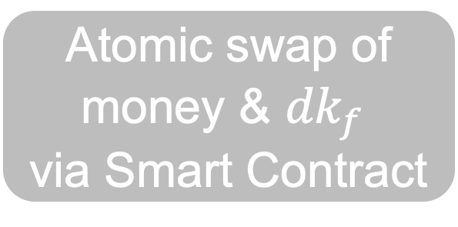
Functional Fair Exchange via Smart Contracts + FE
1
$$ad=(ek, ct)$$
money,
f: function
(Eg: fine-tuning ML model)
x: sensitive info
(Eg: medical records)
2
$$f$$
Buyer
Seller
1
$$(ek, dk) ←FE.Setup(1λ)$$
Atomic swap of
money & ${dk}_{f}$
via Smart Contract
$$ct ←FE.Encrypt\left(ek, x\right)$$
3
$${dk}_{f} ←FE.KGen(dk, f)$$
Downsides of Smart Contracts
High on-chain costs
Incompatability with Bitcoin
$$f(x)←FE.Decrypt({dk}_{f}, ct)$$
Notes:
Taking a step back, we can observe that the smart contract is essentially enabling the atomic swap of money and functional decryption key dk_f. This so far completes a conceptual explanation of how smart contracts can be used to build functional fair exchange. So, are we done?
Well, not really. It is well-known that smart contracts result in high on-chain costs and furthermore, Bitcoin’s scripting language is not powerful enough to write general-purpose smart contracts.
12:00

Slide 10

[VST24]: Functional Fair Exchange via Adaptor Signature + FE
1
$$ad=(ek, ct)$$
money,
f: function
(Eg: fine-tuning ML model)
x: sensitive info
(Eg: medical records)
2
$$f$$
Buyer
Seller
1
$$(ek, dk) ←FE.Setup(1λ)$$
Only single signature posted to blockchain
Atomic swap of
money & ${dk}_{f}$
via Adaptor Signature
Atomic swap of
money & ${dk}_{f}$
via Smart Contract
$$ct ←FE.Encrypt\left(ek, x\right)$$
3
$${dk}_{f} ←FE.KGen(dk, f)$$
Limitation
Supports only linear functions f
$$f(x)←FE.Decrypt({dk}_{f}, ct)$$
Notes:
Taking a step back, we can observe that the smart contract is essentially enabling the atomic swap of money and functional decryption key dk_f. This so far completes a conceptual explanation of how smart contracts can be used to build functional fair exchange. So, are we done?
Well, not really. It is well-known that smart contracts result in high on-chain costs and furthermore, Bitcoin’s scripting language is not powerful enough to write general-purpose smart contracts.
12:00

Slide 11
Key Challenge
Can we design Functional Fair Exchange (FFE)
protocols that support a broad class of functions without using smart contracts?
Our Contributions
[VGTS26]: FFE via Adaptor Signatures + Fully Homomorphic Encryption
✅ Supports arbitrary functions
Notes:
So, the key challenge that our work tries to address is: can we design functional fair exchange protocols without using smart contracts?
Our contributions are as follows: In our first work at CCS 2024, we design FFE protocols via adaptor signatures and functional encryption. Here, adaptor signatures are the key ingredient to avoid using smart contracts. Using adaptor signatures in conjunction with functional encryption is quite tricky and we show how to make it work for supporting functions f belonging the class of linear functions. In our upcoming work at Oakland 2026, we show how to broaden the scope beyond linear functions to supporting arbitrary functions by using fully homomorphic encryption instead of functional encryption.
13:00

Slide 12
Our Contributions in detail
[VGTS26]: FFE via Adaptor Signatures + Fully Homomorphic Encryption
Formal definition of Functional Fair Exchange (FFE)
Constructions:
1. FFE from Functional Adaptor Signatures (FAS)
2. FAS from Adaptor Signatures + Fully Homomorphic Encryption
Today (without intermediate FAS abstraction)
Notes:
So, the key challenge that our work tries to address is: can we design functional fair exchange protocols without using smart contracts?
Our contributions are as follows: In our first work at CCS 2024, we design FFE protocols via adaptor signatures and functional encryption. Here, adaptor signatures are the key ingredient to avoid using smart contracts. Using adaptor signatures in conjunction with functional encryption is quite tricky and we show how to make it work for supporting functions f belonging the class of linear functions. In our upcoming work at Oakland 2026, we show how to broaden the scope beyond linear functions to supporting arbitrary functions by using fully homomorphic encryption instead of functional encryption.
13:00

Slide 13

1
Construction Blueprint
Implementation & Performance
2
Notes:
46:30

Slide 14

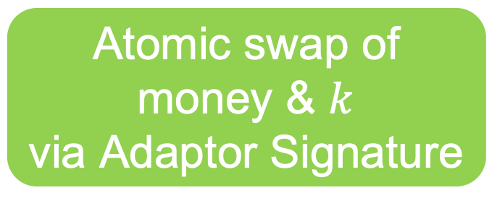
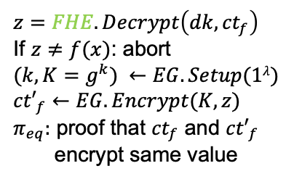





FFE via Adaptor Signatures + FHE
1
$$ad=(ek, ct)$$
money,
f: function
(Eg: fine-tuning ML model)
x: sensitive info
(Eg: medical records)
2
$${ct}_{f}, f$$
Buyer
Seller
3
${K, ct′}_{f}$, $π_{eq}$
2
$${ct}_{f} ←FHE.Eval\left(ek, f, ct\right)$$
1
$$(ek, dk) ←FHE.Setup(1λ)$$
$$ct ←FHE.Encrypt\left(ek, x\right)$$
Only single signature posted to blockchain
Atomic swap of
money & $k$
via Adaptor Signature
$$z=FHE.Decrypt\left(dk, {ct}_{f}\right)$$
If $z≠f(x)$: abort
$$(k, K=g^{k}) ←EG.Setup(1λ)$$
$${ct′}_{f}←EG.Encrypt(K, z)$$
$π_{eq}:$ proof that ${ct}_{f}$ and ${ct′}_{f}$
encrypt same value
3
$$f(x)←EG.Decrypt(k, {ct′}_{f})$$
Novelty
Notes:
Second, our FHE based protocol is a little different.
First, seller sends ciphertext ct which is FHE encryption of x.
Then, the buyer can evaluate the function f on it and send back ct_f to the seller.
At this point, the seller can’t just give away decryption key dk to the buyer since it will allow the buyer to recover x fully. So, our idea is instead to decrypt ct_f to obtain message z and re-encrypt this under El Gamal encryption and send this to the buyer. Crucially, the seller also needs to give a nizk proof pi_eq proving that ct_f and ct’_f encrypt the same value.
Once this is done, it can be observed that all remains to do is an atomic swap of money and the el gamal key k. This can be done using adaptor signatures as before. At the end, the buyer uses the El Gamal key to decrypt the ciphertext ct’_f and recover f(x).
15:15

Slide 15

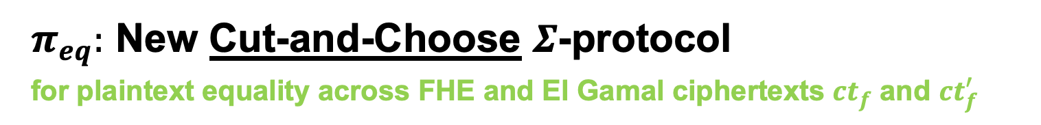


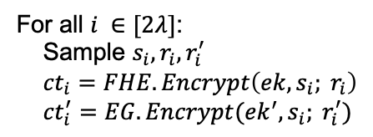
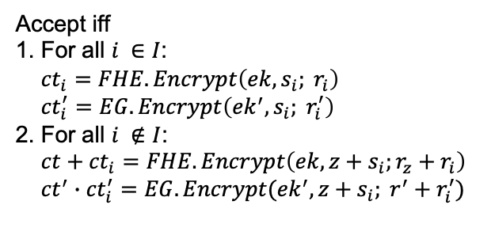


$π_{eq}:$ New Cut-and-Choose $Σ$-protocol
for plaintext equality across FHE and El Gamal ciphertexts $ct_{f}$ and $ct_{f}^{′}$
$$stmt=\left(ek, ek^{′}, ct, ct^{′}\right), wit=\left(z, r_{z}, r^{′}\right) s.t.$$
$$ct=FHE.Encrypt\left(ek, z; r_{z}\right), ct^{′}=EG.Encrypt(ek^{′}, z;r^{′})$$
Prover
Verifier
For all $i ∈[2λ]$:
Sample $s_{i}, r_{i}, r_{i}^{′}$
${ct}_{i}=FHE.Encrypt\left(ek, s_{i}; r_{i}\right)$
${ct}_{i}^{′}=EG.Encrypt({ek}^{′}, s_{i}; r_{i}^{′})$
$$\{{ct}_{i}, {ct}_{i}^{′}\}_{i ∈[2λ]}$$
$$I$$
Choose random set $I$ of size $λ$
$$\{s_{i}, r_{i}, r_{i}^{′}\}_{i ∈I},$$
$$\{{z+s}_{i}, {r_{z}+r}_{i}, r^{′}+r_{i}^{′}\}_{i ∉I}$$
Accept iff
1. For all $i ∈I$:
${ct}_{i}=FHE.Encrypt\left(ek, s_{i}; r_{i}\right)$
${ct}_{i}^{′}=EG.Encrypt\left({ek}^{′}, s_{i}; r_{i}^{′}\right)$
2. For all $i ∉I$:
$ct+{ct}_{i}=FHE.Encrypt\left(ek, z+s_{i};r_{z}+r_{i}\right)$
${ct}^{′}∙{ct}_{i}^{′}=EG.Encrypt({ek}^{′}, z+s_{i}; r^{′}+r_{i}^{′})$
Notes:
50:30

Slide 16



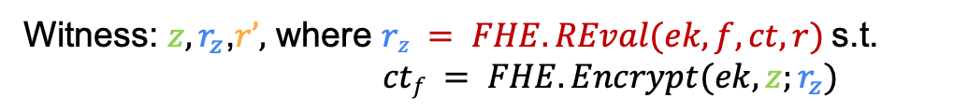

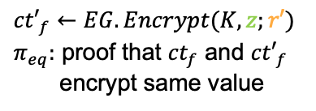

FFE via Adaptor Signatures + FHE
Buyer ( f, )
Seller ( x )
$$ct ←FHE.Encrypt\left(ek, x;r\right)$$
$${ct}_{f} ←FHE.Eval\left(ek, f, ct\right)$$
Naïve and inefficient witness computation:
Depends on complexity of $f$ !
$$z=FHE.Decrypt\left(dk, {ct}_{f}\right)$$
Witness: $z,r_{z}\text{,} r’,$ where $rz = FHE.REval(ek, f, ct, r)$s.t.
$ctf = FHE.Encrypt(ek, z;r_{z})$
$${ct′}_{f}←EG.Encrypt(K, z;r′)$$
$π_{eq}:$ proof that ${ct}_{f}$ and ${ct′}_{f}$
encrypt same value
Optimized and efficient witness computation:
Depends only on output length of $f$ !
Witness: $z,r_{z}\text{,}r’,$where $rz = FHE.REval(r_{ksk}, ctf) = \left\langle rksk, ctf\right\rangle$s.t.
$FHE.KeySwitch(ksk, ctf) = FHE.Encrypt(ek, z;r_{z})$
Notes:
54:00

Slide 17
Functional Fair Exchange: Comparison
 | Smart contracts + FE | Adaptor Signatures + PKE | Adaptor Signatures + FE [VST24] | Adaptor Signatures + FHE [VGTS26]
Function f | arbitrary | identity | linear | arbitrary
Fairness | ✅ | ✅ | ✅ | ✅
Privacy | ✅ | ✅ | ✅ | ✅
On-chain Costs | ❌ | ✅ | ✅ | ✅
Bitcoin Compatibility | ❌ | ✅ | ✅ | ✅
Notes:
In summary, a comparison of these FFE protocols looks as follows.
Smart contract based approach support arbitrary functions but has high on-chain costs and is incompatible with blockchains such as bitcoin.
Adaptor signatures can be used in conjunction with PKE to support identity functions.
Replacing PKE with FE allows us to support linear functions.
Lastly, FHE based protocol allows us to broaden the functionality to arbitrary functions.
16:15

Slide 18
FFE via Adaptor Signatures + FHE: Security
Theorem:
Unforgeability of Sig + Witness Extractability of AS + Adaptive Soundness of NIZK
➔ Buyer Fairness of FFE
Zero-Knowledge of NIZK + Semantic Security of FHE + Semantic Security of El Gamal ➔Seller Fairness of FFE
Zero-Knowledge of NIZK + Semantic Security of FHE
➔Seller Privacy of FFE

Slide 19
1
Construction Blueprint
Implementation & Performance
2
Notes:
46:30

Slide 20
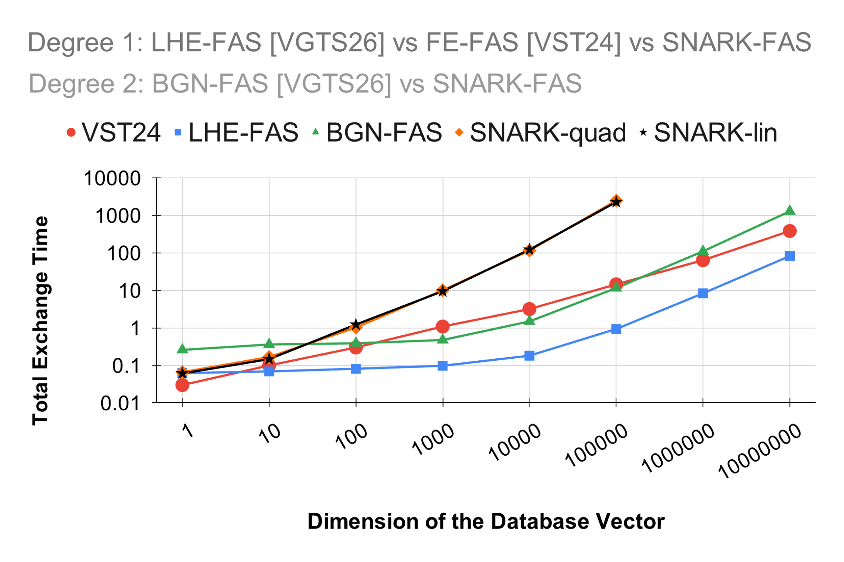
Implementation and Performance
Aside:
FAS ➔ FFE
Notes:
55:30

Slide 21
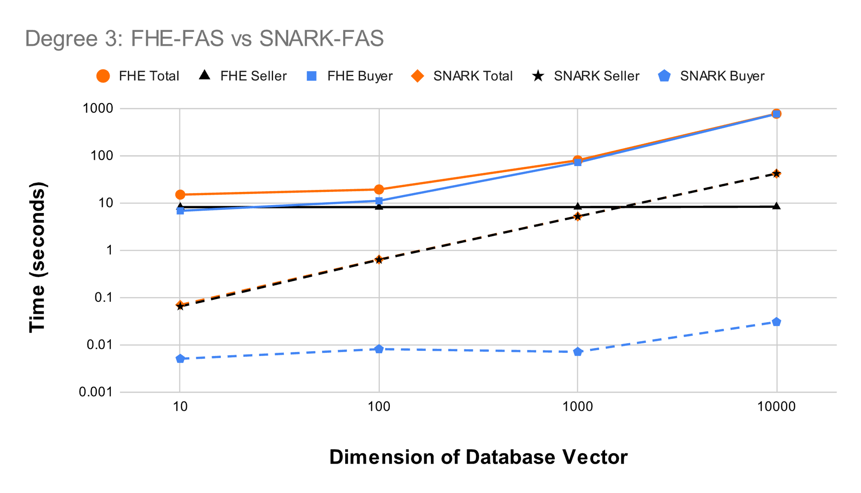
Implementation and Performance
Aside:
FAS ➔ FFE
Notes:
56:30

Slide 22
Summary
Functional Fair Exchange
FFE via AS + FHE: seller optimized
Also in paper
Definition: Functional Fair Exchange
FFE from FAS construction
FAS from AS + FHE
  Instantiations: El Gamal, BGN, TFHE
Proofs
Notes:
57:00

Slide 23
Open Questions
Computation vs communication tradeoffs
Multi-seller setting
Dual notion (buyer: x, seller: f)
Enabling more use cases on Bitcoin
(i.e., without using Smart Contracts)
Notes:
58:00

Slide 24


Thank You!
nikhilvanjani61@gmail.com
Paper and Code
1-hour talk
Notes:
58:00

Slide 25
Hiring!
Role: Senior Researcher
Ideal Candidate:
PhD in distributed consensus, cryptographic protocols, or related area
Strong interest in doing impactful research in blockchain space
Reach out to me (nikhil@babylonchain.io) or David Tse (dntse@babylonchain.io)

Slide 27
Extra Slides
Notes:
Section 0: 12:00 min.
Section 1: 29:00 min (17:00 min).
Section 2: 34:00 min (4:30 min).
Section 3: 59:00 min (25 min).

Slide 28
1
Warmup: Fair Exchange via AS + PKE
Functional Fair Exchange via AS + FE [VST24]
2
3
Functional Fair Exchange via AS + FHE [VGTS26]
4
Implementation & Performance
Notes:
The plan for the rest of the talk is as follows.
First, as a warm-up, we will understand adaptor signatures and how they can be used to build fair exchange protocols.
Second, we will see how to build functional fair exchange using functional encryption and understand why it can only support linear functions.
Third, I will highlight the key ideas needed for making out FHE based protocol efficient.
Lastly, I will discuss the implementation and performance of our protocols.
17:40

Slide 29
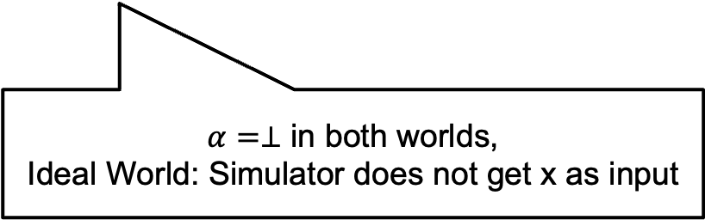


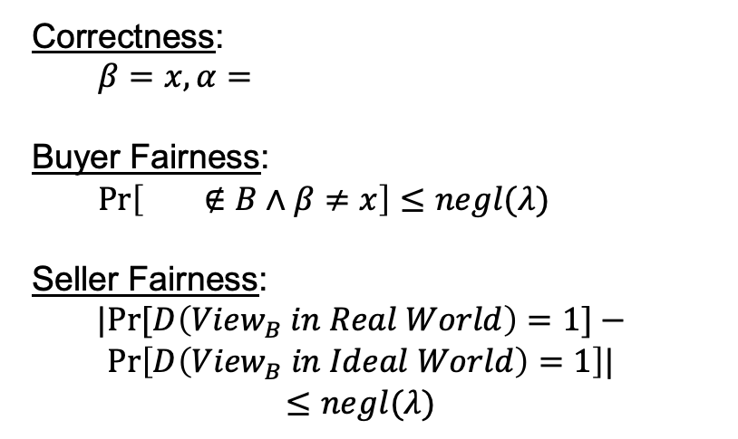




Fair Exchange [dMVVZ25]
Correctness:
$β=x, α=$
Buyer Fairness:
$\operatorname{Pr}\left[ ∉B∧β≠x\right]≤negl(λ)$
Seller Fairness:
$$|Pr⁡[D\left({View}_{B} in Real World\right)=1]−$$
$$Pr\left[D\left({View}_{B} in Ideal World\right)=1\right]|$$
$$≤negl(λ)$$
$$pp ←Setup(1^{λ})$$
Buyer
( )
Seller
( $x$ )
$$ad$$
$$ad←AdGen(pp, x)$$
$$β$$
$$α$$
$α=⊥$ in both worlds,
Ideal World: Simulator does not get x as input
Notes:
Let us start by defining Fair Exchange. There are many definitions out there and we follow the definition of dMVVZ25 since it is easy to understand.
Setup algorithm generates public parameters which are available to both buyer and seller.
Buyer has private inputs some bitcoins and seller has private input x.
Seller runs AdGen algorithm and sends advertisement to the buyer.
Then in the exchange phase, buyer, seller, and a trusted third party participate in an interactive protocol at the end of which buyer’s output is \beta, and seller’s output is \alpha. For visual simplicity, I have skipped the TTP but will highlight it in the protocols whereever it appears.
Correctness requires that if everyone is honest then beta = x and alpha = bitcoin.
Buyer fairness requires that if the buyer sent the money (aka, bitcoins don’t belong to the buyer anymore), then, \beta = x with high probability. Put another way, we require that probability that bitcoins don’t belong to the buyer and \beta \neq x is negligible.
Seller fairness requires that if the seller did not obtain money (aka, alpha = bot) then, buyer must not learn x. This is formalized via a simulation style definition where a ppt distinguisher can’t distinguish views of buyer in the real and ideal world, where the ideal world is obtained from a simulator that does not get x as input.
20:00

Slide 30
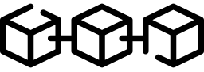
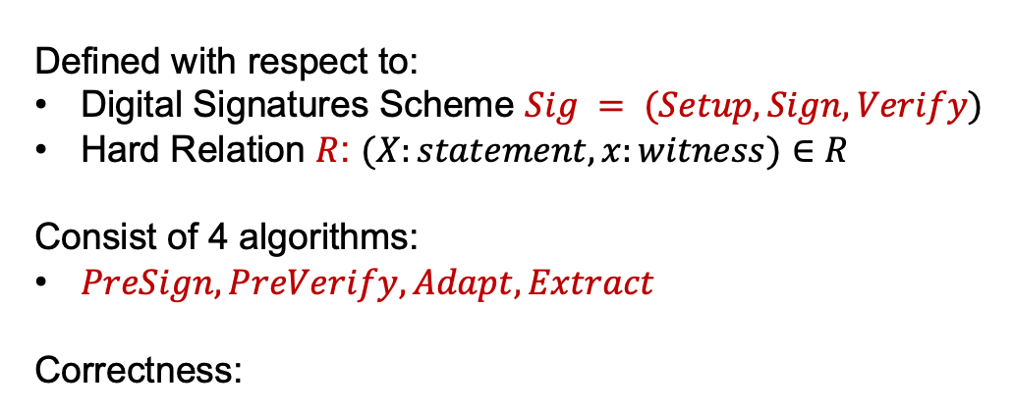




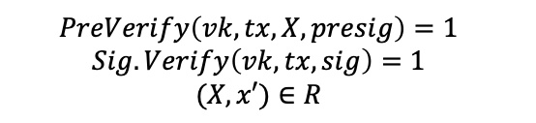




Adaptor Signature (AS)
[AEEFHMMR’21, DOY’22, GSST’24]
Buyer
(sk, )
Seller
(X, x)
Defined with respect to:
Digital Signatures Scheme $Sig = (Setup, Sign, Verify)$
Hard Relation $R$: $(X:statement, x:witness)∈R$
Consist of 4 algorithms:
$PreSign, PreVerify, Adapt, Extract$
Correctness:
$$X$$
$$PreSign$$
$$presig$$
$$PreVerify$$
$$Adapt$$
$$tx, sig$$
$$Extract$$
$$\left(sk, vk\right)←Sig.Setup(1^{λ})$$
$$presig←PreSign\left(sk, tx, X\right)$$
$$sig=Adapt\left(presig, x\right)$$
$$x′=Extract(presig, sig)$$
$$PreVerify\left(vk, tx, X, presig\right)=1$$
$$Sig.Verify\left(vk, tx, sig\right)=1$$
$$(X, x′)∈R$$
If
, then
Notes:
3.5
Adaptor Signatures are defined with respect to a digital signature scheme and a hard relation. The syntax consists of 4 algorithms: … . Let us understand these algorithms via the fair exchange application.
23:00

Slide 31
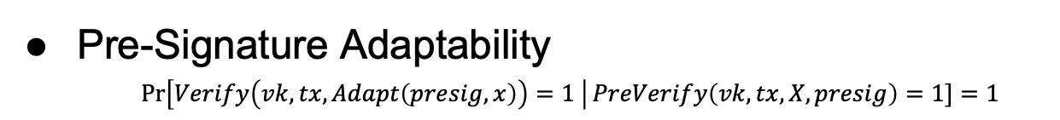
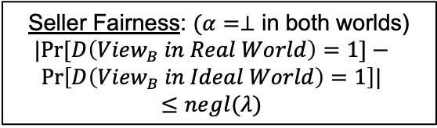

Adaptor Signature (AS): Security
Buyer
(sk, )
Seller
(X, x)
AS: Security against Malicious Seller
$$X$$
Unforgeability
Witness Extractability
Buyer Fairness:
$$\operatorname{Pr}\left[ ∉B∧β≠x\right]≤negl(λ)$$
$$PreSign$$
$$presig$$
$$PreVerify$$
$$Adapt$$
$$tx, sig$$
AS: Security against Malicious Buyer
$$Extract$$
Pre-Signature Adaptability
$\operatorname{Pr}\left[Verify\left(vk, tx, Adapt\left(presig, x\right)\right)=1 \right|PreVerify\left(vk, tx, X, presig\right)=1]=1$
Seller Fairness: $(α=⊥$ in both worlds)
$$|Pr⁡[D\left({View}_{B} in Real World\right)=1]−$$
$$Pr\left[D\left({View}_{B} in Ideal World\right)=1\right]|$$
$$≤negl(λ)$$
Notes:
26:00

Slide 32
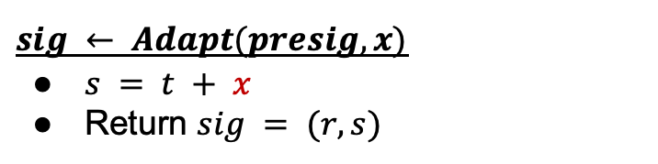
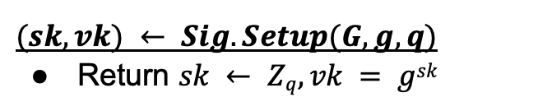
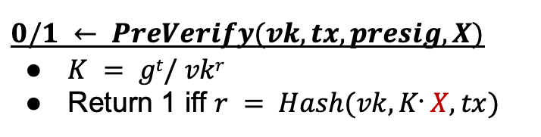
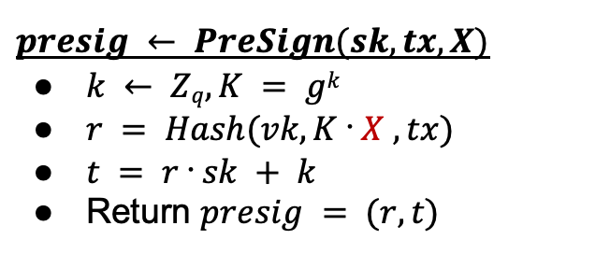
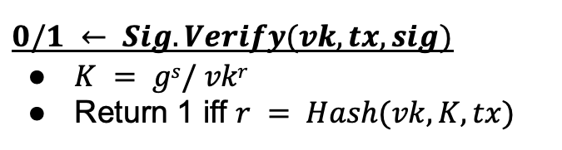
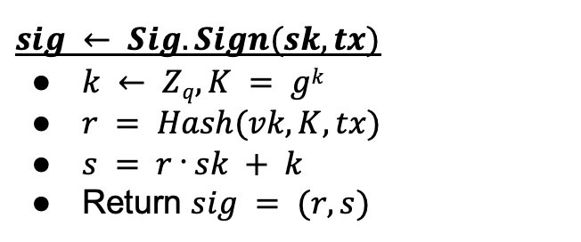
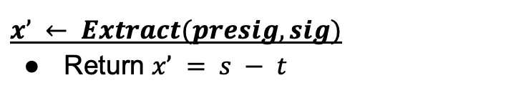
Schnorr Adaptor Signature [AEEFHMMR’21]
$$(sk, vk) ← Sig.Setup(G, g, q)$$
Return $sk ← Zq, vk = gsk$
$$presig ← PreSign(sk, tx, X)$$
$k ← Zq, K = gk$
$r = Hash(vk, K ᐧ X , tx)$
$t = r ᐧ sk + k$
Return $presig = (r, t)$
X = g^{x}
$$sig ← Sig.Sign(sk, tx)$$
$k ← Zq, K = gk$
$r = Hash(vk, K, tx)$
$s = r ᐧ sk + k$
Return $sig = (r, s)$
$$0/1 ← PreVerify(vk, tx, presig, X)$$
$K = gt/ vkr$
Return 1 iff $r = Hash(vk, Kᐧ X, tx)$
$$0/1 ← Sig.Verify(vk, tx, sig)$$
$K = gs/ vkr$
Return 1 iff $r = Hash(vk, K, tx)$
$$sig ← Adapt(presig, x)$$
$s = t + x$
Return $sig = (r, s)$
$$x’ ← Extract(presig, sig)$$
Return $x’ = s − t$
Notes:
30:00

Slide 33
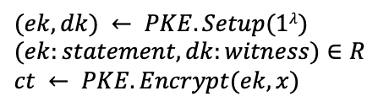
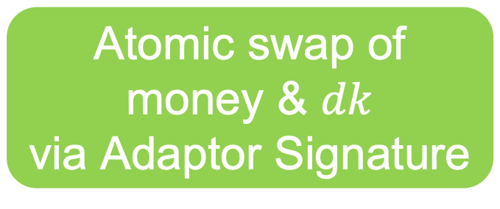



Fair Exchange via Adaptor Signatures (AS)
Buyer ( )
Seller ( $x$ )
$$(ek, dk) ← PKE.Setup(1λ)$$
$$(ek:statement, dk:witness)∈R$$
$$ct ← PKE.Encrypt(ek, x)$$
$$ad=(ek, ct)$$
Atomic swap of
money & $dk$
via Adaptor Signature
$$x = PKE.Decrypt(dk, ct)$$
Notes:
32:30

Slide 34


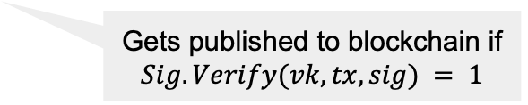




Fair Exchange via Adaptor Signatures (AS)
Buyer ( )
Seller ( $x$ )
$$(ek, dk) ← PKE.Setup(1λ)$$
$$(ek:statement, dk:witness)∈R$$
$$ct ← PKE.Encrypt(ek, x)$$
$$ad=(ek, ct)$$
$$\left(sk, vk\right)←Sig.Setup(1^{λ})$$
tx: buyer seller
$$presig$$
If $PreVerify\left(vk, tx, ek, presig\right)=0$: abort
$$tx, sig$$
$$sig=Adapt\left(presig, dk\right)$$
$$presig←PreSign\left(sk, tx, ek\right)$$
Gets published to blockchain if
$$Sig.Verify(vk, tx, sig) = 1$$
$dk ← Extract(presig, sig$)
Blockchain
$$x = PKE.Decrypt(dk, ct)$$
Notes:
33:00

Slide 35
Fair Exchange via Adaptor Signatures (AS)
Buyer ( )
Seller ( $x$ )
$$(ek, dk) ← PKE.Setup(1λ)$$
$$(ek:statement, dk:witness)∈R$$
$$ct ← PKE.Encrypt(ek, x)$$
$$ad=(ek, ct)$$
Example Instantiation: PKE = El Gamal Encryption
R = Discrete Log Relation
Sig = Schnorr Signature
AS = Schnorr Adaptor Signature
$$\left(sk, vk\right)←Sig.Setup(1^{λ})$$
tx: buyer seller
$$presig$$
If $PreVerify\left(vk, tx, ek, presig\right)=0$: abort
$$tx, sig$$
$$sig=Adapt\left(presig, dk\right)$$
$$presig←PreSign\left(sk, tx, ek\right)$$
Gets published to blockchain if
$$Sig.Verify(vk, tx, sig) = 1$$
$dk ← Extract(presig, sig$)
Blockchain
$$x = PKE.Decrypt(dk, ct)$$
Notes:
33:00

Slide 36



Buyer and Seller Fairness
Buyer
(sk, )
Seller
(x)
Buyer Fairness
$$ad=(ek, ct)$$
Unforgeability of AS
Witness Extractability of AS
$$presig$$
$$tx, sig$$
$$x$$
Seller Fairness
Pre-Signature Adaptability of AS
Semantic Security of PKE
Notes:
35:00

Slide 37



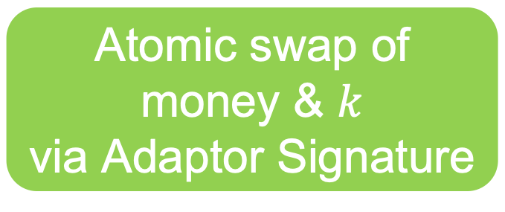


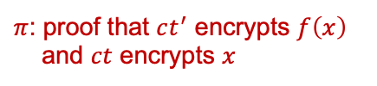
Strawman: FFE via Adaptor Signatures + PKE + NIZK
Buyer ( f, )
Seller ( x )
1
$$ad=(ek, ct)$$
1
$$(ek, dk) ←PKE.Setup(1λ)$$
$$ct ←PKE.Encrypt\left(ek, x\right)$$
2
$$f$$
3
$\left(k, K=g^{k}\right)←EG.Setup(1λ$)
$$ct^{′}←EG.Encrypt\left(K, f\left(x\right)\right)$$
3
$$K, ct^{′}, π$$
$π$: proof that $ct^{′}$ encrypts $f\left(x\right)$
and $ct$ encrypts $x$
Only single signature posted to blockchain
Atomic swap of
money & $k$
via Adaptor Signature
$$f(x)←EG.Decrypt(k, ct′)$$
Notes:
36:00

Slide 38
Strawman: FFE via Adaptor Signatures + PKE + NIZK
Main Challenge: Design Seller-optimized protocol?
Inefficient Seller: cryptographic operations depend on complexity of f
$π$: proof that $ct^{′}$ encrypts $f\left(x\right)$
and $ct$ encrypts $x$
In fine-tuning ML application,
Buyer has more compute resources than Seller
👀
Notes:
36:30

Slide 39
1
Warmup: Fair Exchange via AS + PKE
Functional Fair Exchange via AS + FE [VST24]
2
3
Functional Fair Exchange via AS + FHE [VGTS26]
4
Implementation & Performance
Notes:
37:00

Slide 40
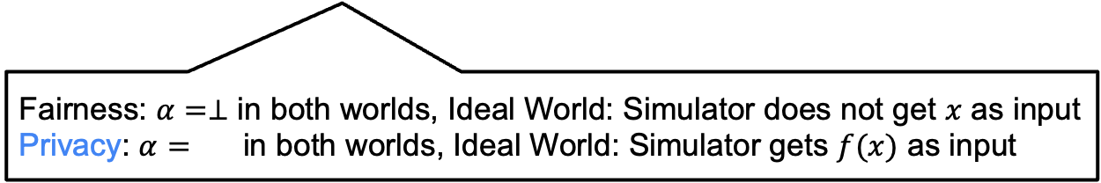
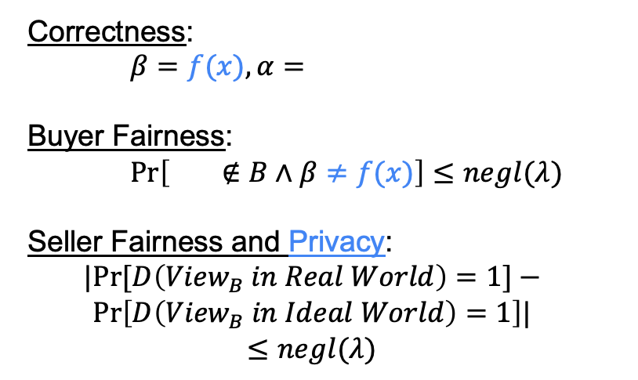
Functional Fair Exchange [VGTS26]
Correctness:
$β=f(x), α=$
Buyer Fairness:
$\operatorname{Pr}\left[ ∉B∧β≠f(x)\right]≤negl(λ)$
Seller Fairness and Privacy:
$$|Pr⁡[D\left({View}_{B} in Real World\right)=1]−$$
$$Pr\left[D\left({View}_{B} in Ideal World\right)=1\right]|$$
$$≤negl(λ)$$
$$pp ←Setup(1^{λ})$$
Buyer
(f, )
Seller
( $x$ )
$$ad$$
$$ad←AdGen(pp, x)$$
$$β$$
$$α$$
Fairness: $α=⊥$ in both worlds, Ideal World: Simulator does not get $x$ as input
Privacy: $α=$ in both worlds, Ideal World: Simulator gets $f(x)$ as input
Notes:
39:30

Slide 41
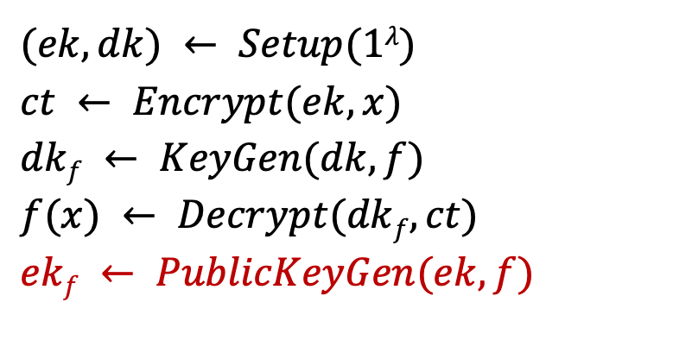

Augmenting FE with PublicKeyGen Algorithm
$$(ek, dk) ← Setup(1λ)$$
$$ct ← Encrypt(ek, x)$$
$$dkf ← KeyGen(dk, f)$$
$$f(x) ← Decrypt(dkf, ct)$$
$$ekf ← PublicKeyGen(ek, f)$$
Deterministic algorithm
Does not affect Correctness and Security definitions of FE
New Property: $R$-compliant FE
$(ekf, dkf) ∈ R$, where $R$ is a hard relation
Notes:
we augment FE with a public keygen algorithm. This is analogous to the keygen algorithm, but differs in that it takes mpk and f as input and outputs pkf.
We need it to be a deterministic algorithm. Further, this algorithm does not affect the correctness or security definitions of FE since it is a public algorithm. So, why are are we even doing this? It will be useful for our FAS construction on the next slide.
We define a new compliance property for FE. We say that an FE scheme is R-compliant if (pkf, skf) satisfy the hard relation R.
42:00

Slide 42


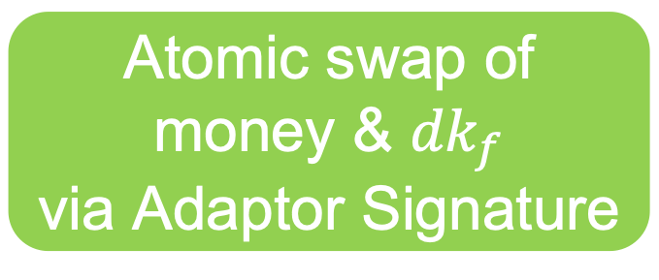


[VST24]: FFE via Adaptor Signatures + FE
Buyer ( f, )
Seller ( x )
1
$$ad=(ek, ct)$$
1
$$(ek, dk) ←FE.Setup(1λ)$$
$$ct ←FE.Encrypt\left(ek, x\right)$$
2
$$f$$
3
$${dk}_{f} ←FE.KGen(dk, f)$$
Only single signature posted to blockchain
Atomic swap of
money & ${dk}_{f}$
via Adaptor Signature
$$f(x)←FE.Decrypt({dk}_{f}, ct)$$
Notes:
43:00

Slide 43
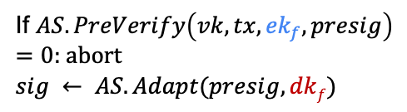



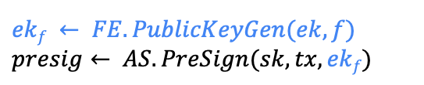

[VST24]: FFE via Adaptor Signatures + FE
Buyer ( f, )
Seller ( x )
1
$$ad=(ek, ct)$$
1
$$(ek, dk) ←FE.Setup(1λ)$$
$$ct ←FE.Encrypt\left(ek, x\right)$$
2
$$f$$
3
$${dk}_{f} ←FE.KGen(dk, f)$$
$$\left(sk, vk\right)←Sig.Setup(1^{λ})$$
tx: buyer seller
$$ekf ← FE.PublicKeyGen(ek, f)$$
$$presig← AS.PreSign(sk, tx, ekf)$$
$$tx, presig$$
2
3
$$tx, sig$$
(via blockchain)
If $AS.PreVerify\left(vk, tx, {ek}_{f}, presig\right)$
$=0$: abort
$$sig ← AS.Adapt(presig, dkf)$$
$${dk}_{f}=AS.Extract(presig, sig)$$
$$f(x)←FE.Decrypt({dk}_{f}, ct)$$
Notes:
44:00

Slide 44
[VST24]: FFE via Adaptor Signatures + FE
Theorem:
Unforgeability of AS + Witness Extractability of AS ➔ Buyer Fairness of FFE
Pre-signature Adaptability of AS + IND-sec of FE ➔Seller Fairness of FFE
Pre-signature Adaptability of AS + IND-sec of FE ➔Seller Privacy of FFE (variant)
Challenge 1: Compatibility of FE and AS
If AS is for hard relation R, then FE needs to be R-compliant
Need to choose AS that is used on blockchains
Solution:
Schnorr AS: R is Discrete Log relation
[ABDP15] FE for linear functions can be augmented with PublicKeyGen algorithm to make it R-compliant
If $AS.PreVerify\left(vk, tx, {ek}_{f}, presig\right)$
$=0$: abort
$$sig ← AS.Adapt(presig, dkf)$$
Notes:
46:00

Slide 45

Challenge 2: No known FE scheme beyond linear functions
that is R-compliant
Build Functional Fair Exchange (FFE) using FHE
Notes:
46:00

Slide 47
FAS definition
Notes:
Section 0: 12:00 min.
Section 1: 29:00 min (17:00 min).
Section 2: 34:00 min (4:30 min).
Section 3: 59:00 min (25 min).

Slide 48
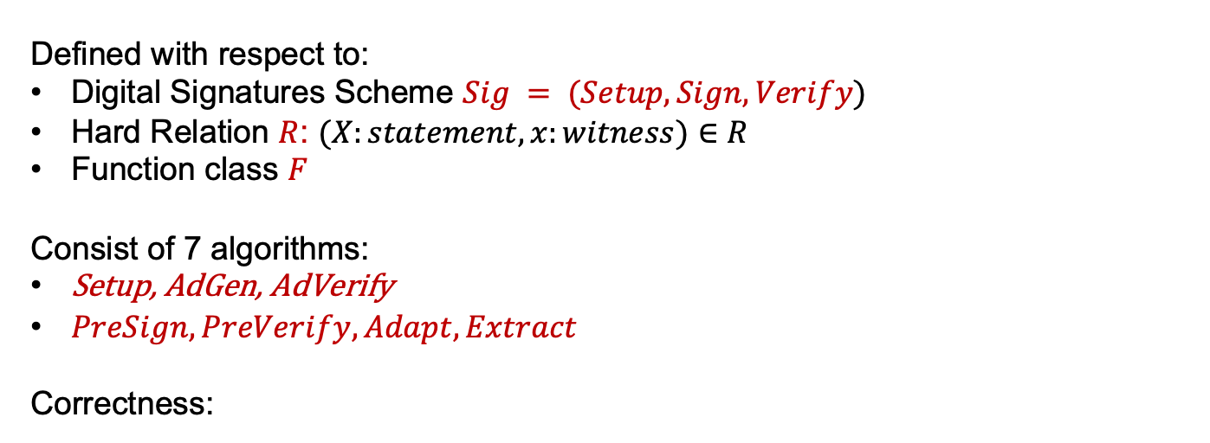
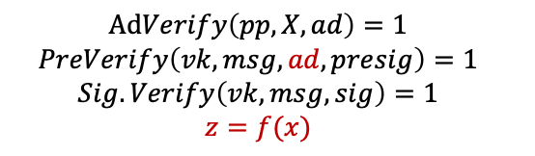
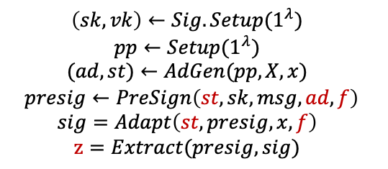
Functional Adaptor Signature (AS) [VST24]
Defined with respect to:
Digital Signatures Scheme $Sig = (Setup, Sign, Verify)$
Hard Relation $R$: $(X:statement, x:witness)∈R$
Function class $F$
Consist of 7 algorithms:
Setup, AdGen, AdVerify
$PreSign, PreVerify, Adapt, Extract$
Correctness:
$$\left(sk, vk\right)←Sig.Setup(1^{λ})$$
$$pp←Setup(1^{λ})$$
$$(ad, st)←AdGen(pp, X, x)$$
$$presig←PreSign\left(st, sk, msg, ad, f\right)$$
$$sig=Adapt\left(st,presig, x, f\right)$$
$$z=Extract(presig, sig)$$
$$AdVerify\left(pp, X, ad\right)=1$$
$$PreVerify\left(vk, msg, ad, presig\right)=1$$
$$Sig.Verify\left(vk, msg, sig\right)=1$$
$$z=f(x)$$
If
, then
Notes:
3.5
Adaptor Signatures are defined with respect to a digital signature scheme and a hard relation. The syntax consists of 4 algorithms: … . Let us understand these algorithms via the fair exchange application.

Slide 49




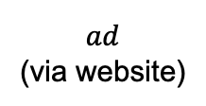




Functional Fair Exchange via FAS
Buyer
Seller
$$(pp, ad, sk, vk)$$
$$(pp, X, x, st, vk)$$
Trusted Third Party
$$pp ← Setup(1λ)$$
$$(sk, vk) ← Sig.Setup(1λ)$$
$$(X: statement, x: witness) ∈ R$$
$$vk$$
$$(ad, st) ← AdGen(pp, X, x)$$
$$ad$$
(via website)
If $AdVerify(pp, X, ad)=0$: abort
Notes:
4.5
A trusted third party runs the Setup algorithm and outputs the public parameters pp to both seller and buyer.
The buyer samples its signing and verification keys and sends vk to the seller. The seller sample a statement capital X and a witness x satisfying the relation R and sends the statement capital X to the buyer.
Suppose now the buyer wants to buys a function f \in F. Then, the buyer creates a transaction tx for this purpose.
The main protocol begins after this point that I will describe on the next slide. For sake of simplicity going forward, we will assume the inputs of the buyer are (pp, X, sk, vk, tx, f) and those of the seller are (pp, X, x, vk) as described here.

Slide 50

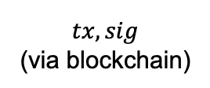


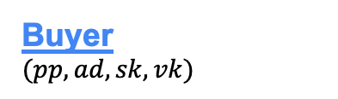
Functional Fair Exchange via FAS
Buyer
$$(pp, ad, sk, vk)$$
Seller
$$(pp, X, x, st, vk)$$
f ∈ F
tx: buyer seller
$$presig←PreSign\left(st, sk, tx, ad, f\right)$$
If $PreVerify\left(vk, msg, ad, presig\right)=0$: abort
$$sig=Adapt\left(st,presig, x, f\right)$$
$$tx, sig$$
(via blockchain)
$$f(x)=Extract(presig, sig)$$
Notes:
5.5
The seller runs the AdGen algorithm and sends the ad to the buyer. This does not need a secure private channel between the two and seller can do this by publishing ad on a website. The buyer verifies the ad via the AdVerify algorithm.
If the ad verification passes, then, it engages in an interactive protocol with the buyer to run FPreSign and compute the presignature. The seller verifies the presignature via FPreVerify algorithm.
If the presignature verification passes, the seller uses the witness x and function f to adapt the presignature into a full-signature and publishes the transaction and signature on the blockchain to get the payment from the buyer.
Once the buyer sees the transaction on the blockchain, it runs the functional extract algorithm on presignature and signature to extract f(x) from them.

Slide 51




Functional Adaptor Signature Security
Security against Malicious Seller
Buyer
Seller
Unforgeability
Witness Extractability
$$ad$$
$$presig$$
Security against Malicious Buyer
$$tx, sig$$
$$f(x)$$
Pre-Signature Adaptability
Witness Privacy
NEW
Notes:
6
Let me briefly touch about FAS security. We define FAS security properties against malicious seller and buyer. Against malicious seller, we need unforgeability and witness extractability. Against malicious buyer, we need pre-signature adaptability and witness privacy.
The first three properties are similar to those considered in standard adaptor signatures and I won’t go into their details today.
I will talk a bit about witness privacy, which is the new security property of FAS.

Slide 52
FAS Security: Witness Privacy
Three Notions
Inspired by privacy notions studied in
Zero-Knowledge Proofs
Witness Indistinguishability
Witness Hiding
Zero-Knowledge
Strongest
Notes:
6.5
Witness privacy captures the leakage a malicious buyer learns about x beyond f(x). Inspired by privacy notions studied in functional encryption and zero-knowledge proofs literature, we define three notions of witness privacy, namely witness indistinguishability, witness hiding and zero-knowledge. Zero-knowledge is the strongest among the three and we build constructions satisfying it.

Slide 53
FAS constructions
Notes:
Section 0: 12:00 min.
Section 1: 29:00 min (17:00 min).
Section 2: 34:00 min (4:30 min).
Section 3: 59:00 min (25 min).

Slide 54
Strawman: NIZK + Schnorr Adaptor Signature
Buyer
(pp, X, sk, vk, tx, f)
Seller
(pp, X, x, vk)
ad
1
ad ← AdGen(pp, X, x)
2
presig ← FPreSign(sk, tx, X, ad, f)
sig
3
sig ← Adapt(presig, x, f)
4
f(x) ← FExtract(presig, sig)
Notes:
7
For the strawman construction, I will describe the AdGen, FPreSign, Adapt and FExt algorithms. The remaining algorithms Setup, AdVerifty and FPreVerify follow in a natural way from these and I will skip their description.

Slide 55
[VST24] FAS Scheme: FE + Adaptor Signature (AS)
Buyer
(pp, X, sk, vk, tx, f)
Seller
(pp, X, x, vk)
ad = (mpk, ct)
1
(mpk, msk) ← FE.Setup(1^{λ})
ct ← FE.Encrypt(mpk, x)
2
pk_{f} ← FE.PublicKeyGen(mpk, f)
presig ← AS.PreSign(sk, tx, pk_{f})
f, tx, presig
3
sk_{f} ← FE.KeyGen(msk, f)
sig ← AS.Adapt(presig, sk_{f})
tx, sig
(via blockchain)
4
sk_{f} ← AS.Extract(presig, sig)
f(x) ← FE.Decrypt(sk_{f}, ct)
Notes:
11.5
Having described FE, let’s see how to use it. Now, seller computes ct as an FE encryption of x and sends the ad to the buyer.
The idea for using FE is as follows. Observe that the buyer can learn f(x) if it can obtain functional decryption key sk_f. So, the idea is to use a standard adaptor signature scheme that enables extracting the functional key sk_f.
Towards this, it must be the case that in the Adapt phase, the seller uses sk_f to adapt the pre-signature into a full signature.
And to enable this, the buyer computes pk_f via the PublicKeyGen algorithm and pre-signs with respect to the adaptor statement pk_f.

Slide 56
[VST24] FAS Scheme: FE + Adaptor Signature (AS)
Buyer
Seller
Theorem 1: If the FE scheme is IND secure,
then the FAS construction satisfies WI.
(pp, X, sk, vk, tx, f)
(pp, X, x, vk)
ad = (mpk, ct, 𝜋)
1
(mpk, msk) ← FE.Setup(1^{λ})
ct ← FE.Encrypt(mpk, x)
𝜋: NIZK proof that ct encrypts x
Challenge 1: Compatibility of FE and AS
If AS is for hard relation R, then FE needs to be R-compliant
Need to choose AS that is used on blockchains
2
pk_{f} ← FE.PublicKeyGen(mpk, f)
presig ← AS.PreSign(sk, tx, pk_{f})
Solution:
Schnorr AS: R is Discrete Log relation
[ABDP15] FE for linear functions can be augmented with PublicKeyGen algorithm to make it R-compliant
f, presig
sig
3
sk_{f} ← FE.KeyGen(msk, f)
sig ← AS.Adapt(presig, sk_{f})
4
sk_{f} ← AS.Extract(presig, sig)
f(x) ← FE.Decrypt(sk_{f}, ct)
Notes:
12.25
In the paper, we show the following theorem for this construction. If the FE scheme is indistinguishability secure and the NZIK scheme used in AdGen is zero-knowledge, then the FAS construction satisfies witness indistinguishability witness privacy.
For instantiations, the main challenge here is the compatibility of FE and AS. If AS is for hard relation R, then FE needs to be R-complaint. Further, we are restricted to choosing an adaptor signature scheme that is used on blockchains.
Towards this, our solution is to use Schnorr Adaptor Signature which is for the discrete log relation and show that the IPFE construction by Abdalla et al. can be augmented with an appropriate PublicKeyGen algorithm to make it R-compliant.

Slide 57
[VST24] FAS Scheme: FE + Adaptor Signature (AS)
Buyer
Seller
Question: If the FE scheme is SIM secure,
then does the FAS construction satisfy ZK?
(pp, X, sk, vk, tx, f)
(pp, X, x, vk)
ad = (mpk, ct, 𝜋)
1
(mpk, msk) ← FE.Setup(1^{λ})
ct ← FE.Encrypt(mpk, x)
𝜋: NIZK proof that ct encrypts x
Challenge 2: Simulation secure FE can’t be R-compliant
2
Theorem 2: If the FE scheme is IND secure,
then a variant of this FAS construction satisfies ZK.
Idea: Makes non-black-box use of [ALMT20] compiler that
upgrades IND secure FE to SIM secure FE for linear functions
pk_{f} ← FE.PublicKeyGen(mpk, f)
presig ← AS.PreSign(sk, tx, pk_{f})
f, presig
sig
3
sk_{f} ← FE.KeyGen(msk, f)
sig ← AS.Adapt(presig, sk_{f})
4
sk_{f} ← AS.Extract(presig, sig)
f(x) ← FE.Decrypt(sk_{f}, ct)
Notes:
13
A natural question then is, if the FE scheme used is simulation secure, then is the FAS construction zero-knowledge?
The main challenge here is that simulation secure FE can’t be R-compliant.
So, what we show is in fact that if the FE scheme is indistinguishability secure, then a variant of this FAS construction satisfies zero-knowledge. The main idea here is to make non-black-box use of the [ALMT20] IPFE compiler that upgrades indistinguishability secure IPFE to simulation secure IPFE. I encourage you to look at the paper for more details.

Slide 58
Challenge 3: No known FE scheme beyond linear functions
that is R-compliant
Build FAS using FHE

Slide 59

[VGTS26] FAS Scheme: FHE + Adaptor Signature (AS)
Buyer
(pp, X, sk, vk, tx, f)
Seller
(pp, X, x, vk)
ad = (mpk, ct)
1
(mpk, msk) ← FHE.Setup(1^{λ})
ct = FHE.Encrypt(mpk, x; r)
2
z ← FHE.Decrypt(msk, ct_{f})
If z$≠$ f(x): abort
Sample El Gamal keys (k, K = g^{k})
ct_{z} = EG.Encrypt(K, z; r’)
𝜋_{z} : NIZK proof that ct_{f} and ct_{z} encrypt z
ct_{f} = FHE.Eval(mpk, ct, f)
f, ct_{f}
ct_{z} , 𝜋_{z}, K
presig ← AS.PreSign(sk, tx, K)
f, presig
sig
3
sig ← AS.Adapt(presig, k)
4
k ← Schnorr.Extract(presig, sig)
f(x) ← EG.Decrypt(k, ct_{z})
Notes:
11.5
Having described FE, let’s see how to use it. Now, seller computes ct as an FE encryption of x and sends the ad to the buyer.
The idea for using FE is as follows. Observe that the buyer can learn f(x) if it can obtain functional decryption key sk_f. So, the idea is to use a standard adaptor signature scheme that enables extracting the functional key sk_f.
Towards this, it must be the case that in the Adapt phase, the seller uses sk_f to adapt the pre-signature into a full signature.
And to enable this, the buyer computes pk_f via the PublicKeyGen algorithm and pre-signs with respect to the adaptor statement pk_f.

Slide 60
[VGTS26] FAS Scheme: FHE + Adaptor Signature (AS)
Buyer
(pp, X, sk, vk, tx, f)
Seller
(pp, X, x, vk)
ct = FHE.Encrypt(mpk, x; r)
ct_{z} = EG.Encrypt(K, z; r’)
𝜋_{z} : NIZK proof that ct_{f} and ct_{z} encrypt z
ct_{f} = FHE.Eval(mpk, ct, f)
Efficient! Depends only on output length of f !
Witness: z, r’, r_{z}, where r_{z} = FHE.REval(r_{ksk}, ct_{f}) = < r_{ksk}, ct_{f} > s.t.
FHE.KeySwitch(ksk, ct_{f}) = FHE.Encrypt(mpk, z; r_{z})

Slide 61
Schnorr AS
Notes:
Section 0: 12:00 min.
Section 1: 29:00 min (17:00 min).
Section 2: 34:00 min (4:30 min).
Section 3: 59:00 min (25 min).

Slide 62
Schnorr Adaptor Signature [AEEFHMMR’21]
Defined with respect to:
Schnorr Signatures Scheme Sig = (Setup, Sign, Verify)
Discrete Log Relation R_{DL}:
(X, x) ∈ R_{DL} iff X = g^{x}
Notes:
3.5
Functional Adaptor Signatures are a generalization of Adaptor Signatures. FAS is defined with respect to a digital signature scheme, a hard relation and a function class. The syntax consists of 7 algorithms: … . Let us understand these algorithms via the functional sale application.

Slide 63
Recall: Schnorr Signature [Sch89]
(sk, vk) ← Sig.Setup(G, g, q)
Return sk ← Z_{q}, vk = g^{sk}
sig ← Sig.Sign(sk, tx)
k ← Z_{q}, K = g^{k}
r = Hash(vk, K, tx)
s = r ᐧ sk + k
Return sig = (r, s)
0/1 ← Sig.Verify(vk, tx, sig)
K = g^{s}/ vk^{r}
Return 1 iff r = Hash(vk, K, tx)
Notes:
3.5
Functional Adaptor Signatures are a generalization of Adaptor Signatures. FAS is defined with respect to a digital signature scheme, a hard relation and a function class. The syntax consists of 7 algorithms: … . Let us understand these algorithms via the functional sale application.

Slide 64
Schnorr Adaptor Signature [AEEFHMMR’21]
(sk, vk) ← Sig.Setup(G, g, q)
Return sk ← Z_{q}, vk = g^{sk}
presig ← PreSign(sk, tx, X)
k ← Z_{q}, K = g^{k}
r = Hash(vk, K ᐧ X , tx)
t = r ᐧ sk + k
Return presig = (r, t)
X = g^{x}
sig ← Sig.Sign(sk, tx)
k ← Z_{q}, K = g^{k}
r = Hash(vk, K, tx)
s = r ᐧ sk + k
Return sig = (r, s)
0/1 ← PreVerify(vk, tx, presig, X)
K = g^{t}/ vk^{r}
Return 1 iff r = Hash(vk, Kᐧ X, tx)
0/1 ← Sig.Verify(vk, tx, sig)
K = g^{s}/ vk^{r}
Return 1 iff r = Hash(vk, K, tx)
sig ← Adapt(presig, x)
s = t + x
Return sig = (r, s)
x’ ← Extract(presig, sig)
Return x’ = s - t
Notes:
3.5
Functional Adaptor Signatures are a generalization of Adaptor Signatures. FAS is defined with respect to a digital signature scheme, a hard relation and a function class. The syntax consists of 7 algorithms: … . Let us understand these algorithms via the functional sale application.

Slide 65
Schnorr Adaptor Signature: Correctness
For every tx ∈ {0,1}*, for every (X, x) ∈ R, if
(sk, vk) ← Sig.Setup(1^{λ})
presig ← PreSign(sk, tx, X)
sig ← Adapt(presig, x)
x’ ← Extract(presig, sig)
Then, all of the following hold with probability 1:
PreVerify(vk, tx, presig, X) = 1
Verify(vk, tx, sig) = 1
(X, x’) ∈ R
vk = g^{sk}
presig = (r, t), where
  r = Hash(vk, K ᐧ X , tx)
  t = r ᐧ sk + k
sig = (r, s), where
  s = t + x
x’ = t - s
Notes:
3.5
Functional Adaptor Signatures are a generalization of Adaptor Signatures. FAS is defined with respect to a digital signature scheme, a hard relation and a function class. The syntax consists of 7 algorithms: … . Let us understand these algorithms via the functional sale application.

Slide 66
Schnorr Adaptor Signature: Security
Seller: fairness
✔ baked-in the fair sale protocol via Adaptor Signature
Buyer: fairness
Defined via Witness Extractability of Adaptor Signatures
Buyer: Authenticity
✔ baked-in the Schnorr Adaptor Signature scheme since Discrete Log is a unique witness relation
Notes:
3.5
Functional Adaptor Signatures are a generalization of Adaptor Signatures. FAS is defined with respect to a digital signature scheme, a hard relation and a function class. The syntax consists of 7 algorithms: … . Let us understand these algorithms via the functional sale application.

